Slide 1
Washington/Baltimore High Intensity Drug Trafficking Areas (W/B HIDTA)
Agency Administrator

Slide 2
What Can An Agency Administrator Do?
User Management
Create level 2 users
Alert Management
MOU Management

Slide 3
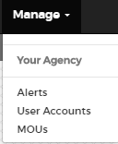
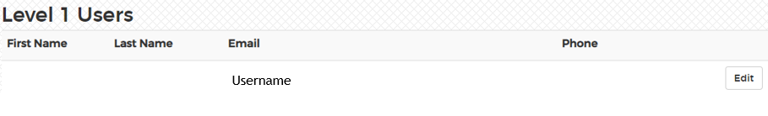
User Management – Level 1 users
Agency administrators are responsible for editing permission levels for Level 1 users
Click Manage >Your Agency> User Accounts

Slide 4
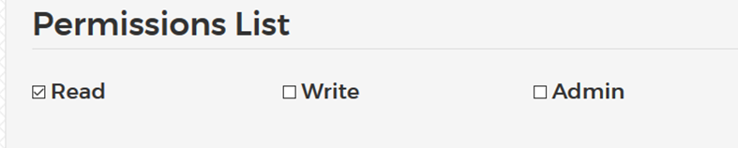
User Management – Level 1 users
Agency administrators are responsible for editing permission levels for Level 1 users
Click Manage >Your Agency> User Accounts
Read: All users have a minimum of read privileges. Users with read permission may submit overdoses and view data for their agency
Write: Users with write privileges may edit entries for their entire agency
Admin: Administrator may designate additional admins, who will have the same abilities as the original administrator

Slide 5
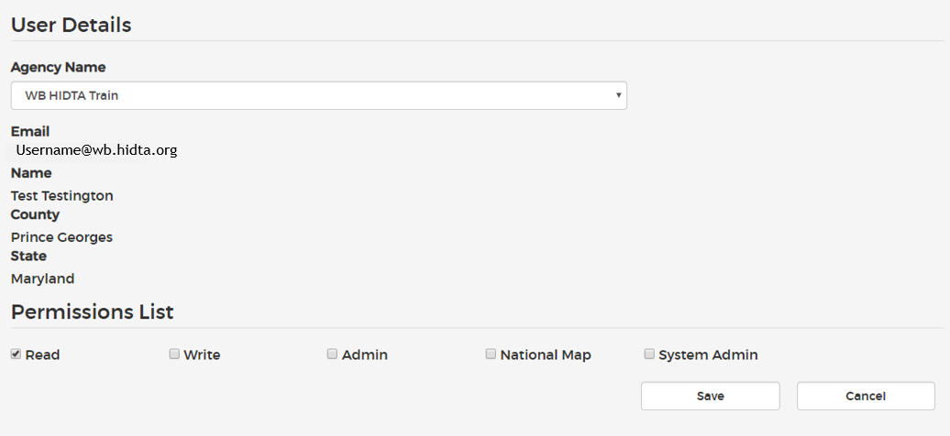
User Management – Level 1 users
Assigned Agency Administrator(s) may view the county and state name associated with a user
Assigned Agency Administrator(s) will click on Edit next to the user name

Slide 6
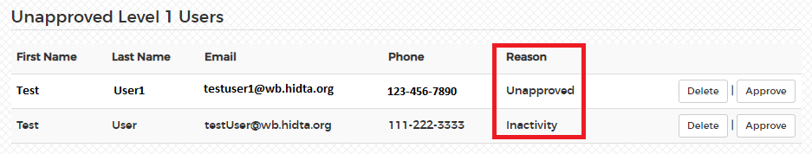
User Management – Level 1 users
All users that have not logged in within the past 6 months will be automatically disabled. An assigned agency administrator(s) may reapprove or delete user(s).

Slide 7
User Management – Level 1 users
Disabling Accounts
If a user should no longer have access to ODMAP Level 1, the administrator has two options for disabling their account; delete or unapprove
Delete
If a user has not entered data into Level 1, their account can be deleted
Unapprove
If a user has entered data into Level 1, their account cannot be deleted. However, their account can be unapproved, removing their ability to access ODMAP

Slide 8
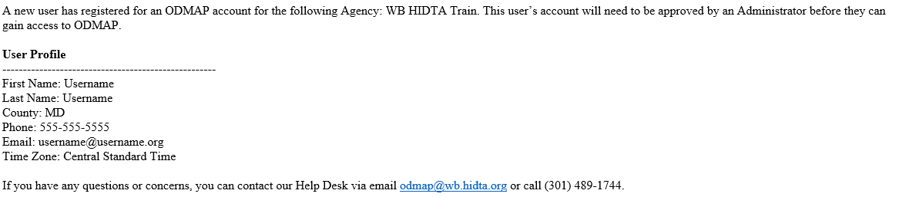
User Management – Level 1 users
Approving New User
Assigned Agency Administrator(s) will have to approve a new Level 1 user registering.
A confirmation e-mail will be sent with new registering user details

Slide 9
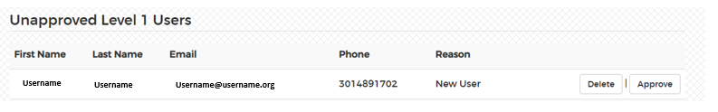
User Management – Level 1 users
Approving New User
Assigned Agency Administrator(s) will approve Level 1 users registering.
An Agency Administrator(s) will approve a new Level 1 user:
Click on Manage>User Accounts>Unapproved Level 1 Users
Please either Approve new registered Level 1 user(s) or Delete user(s)

Slide 10
New Level 1 User E-mail Notification
First e-mail requesting user receives
Second e-mail requesting user receives
Hello {First Name},
Welcome to ODMAP! Your ODMAP user account has been sent to your agency administrator(s) for review. Once approved, you will receive a separate e-mail letting you know that your account has been approved. Please do not attempt to login until you have received your approval email.
Your Email is {Email}
To login into ODMAP, navigate to the site:
  https://odmap.hidta.org
  Enter your email and password
  Select login
If you have any questions or concerns, you can contact our Help Desk via email odmap@wb.hidta.org or call(301) 489-1744.
Hello {First Name},
Welcome to ODMAP! Your agency administrator(s) have approved your account.
If you have any questions or concerns, you can contact our Help Desk via email odmap@wb.hidta.org or call (301) 489-1744.

Slide 11
Establishing Memorandums of Understanding (MOU)
Agencies may now share data between their agencies. By signing a Memorandum of Understanding (MOU) agencies can provide one another with Level 1 Read access to their data. To initiate this process, the administrator can complete the following steps:
Go to “Manage” and select “MOU”
The administrator’s agency will automatically populate the Agency 1 section, with that Agency’s Signor information
Select the Agency you would like to establish the MOU with, from the “Agency Name” dropdown menu.
That Agency’s Signor information will automatically populate the Agency 2 section.
Click send “MOU Request”
Signors from both agencies will receive an email informing them that there has been MOU requesting, with a link to sign the agreement.
Once both Signors have signed the agreement, users from each agency will have read access to one another’s data within 24-48 hours.
Once both Signors have signed the agreement, users from each agency will have read access to one another’s data.
Administrator’s can approved an MOU at anytime

Slide 12
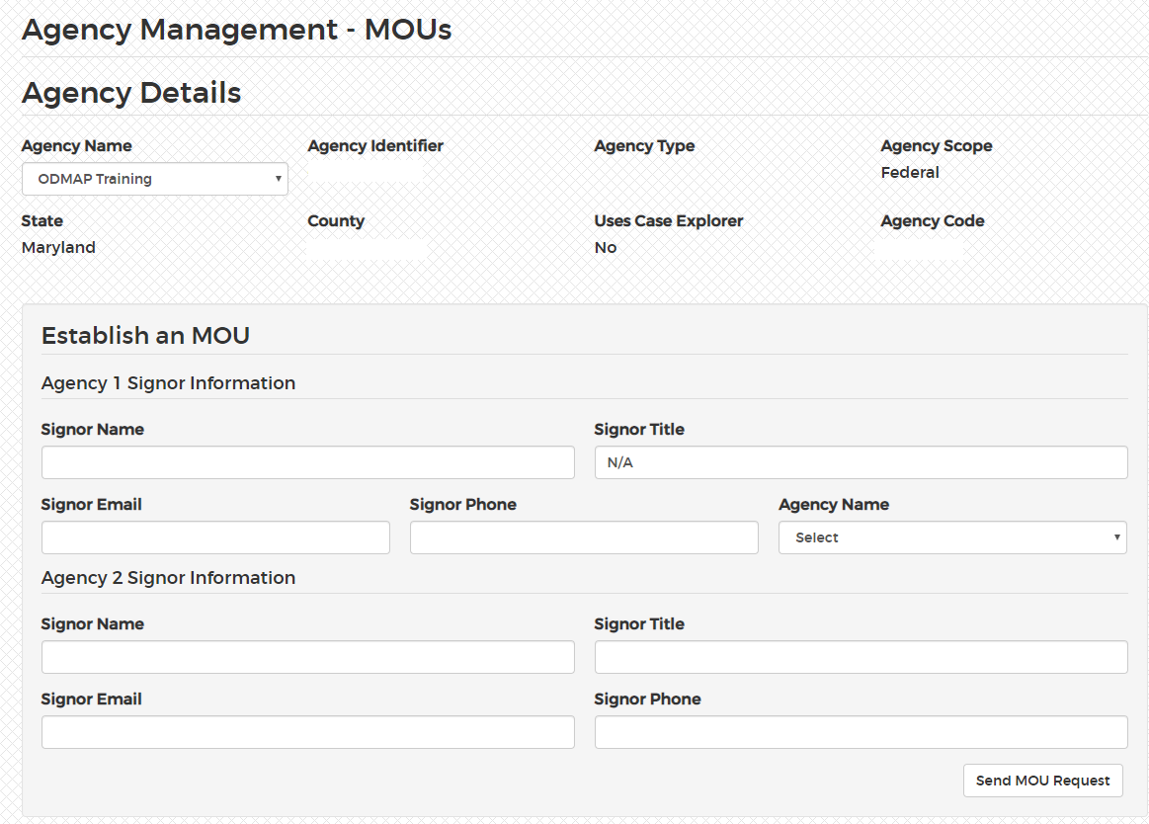
Establishing Memorandums of Understanding (MOU)

Slide 13
Creating Level 2 users
Administrators are responsible for creating Level 2 users (national map access) under their account
In order to create a Level 2 User, name, email, and phone must be entered
A Level 2 account will be created instantly. Once a level 2 user is approved, the user will receive a confirmation email
Users may be unapproved or approved at any time, by the administrator

Slide 14
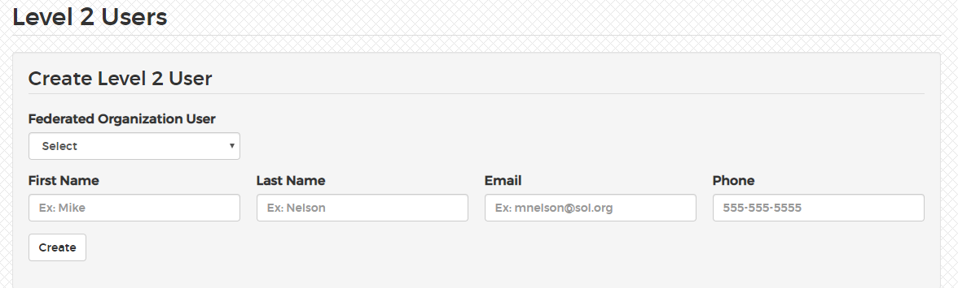
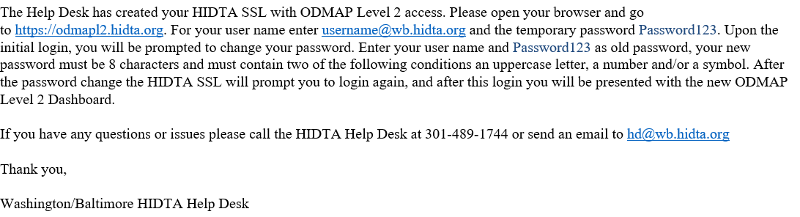
How to register for Level 2
Agency administrators have the ability to create level 2 users for their agency in 4 easy steps!
Step 1: Click on Manage
Step 2: Click User Account
Step 3: Scroll to the bottom for Level 2
Step 4: Enter in the new users name, email and phone number
*Select Federated Organization User if the user being selected is also a federated partner
Once they agency administrator has created a Level 2 user, an e-mail conformation will be sent to the new user

Slide 15
Alert Management
Create a Spike Alert
Create Overdose Alert
Create Statewide Alert
View active spike alerts
View spike alert history

Slide 16
What is a Spike Alert?
Spike alerts can be set up to notify an agency by email if the total overdoses in an area exceeds a pre-determined threshold within a 24-hour period. Spikes alerts can be established for an agency’s own county, as well as nearby or neighboring counties. By establishing spike alerts for nearby counties the program can serve as an early warning system. If a spike in overdoses occurs in a neighboring area, officials can anticipate a spike in their area and prepare.

Slide 17
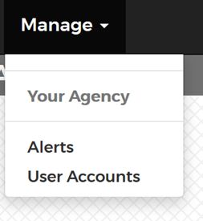
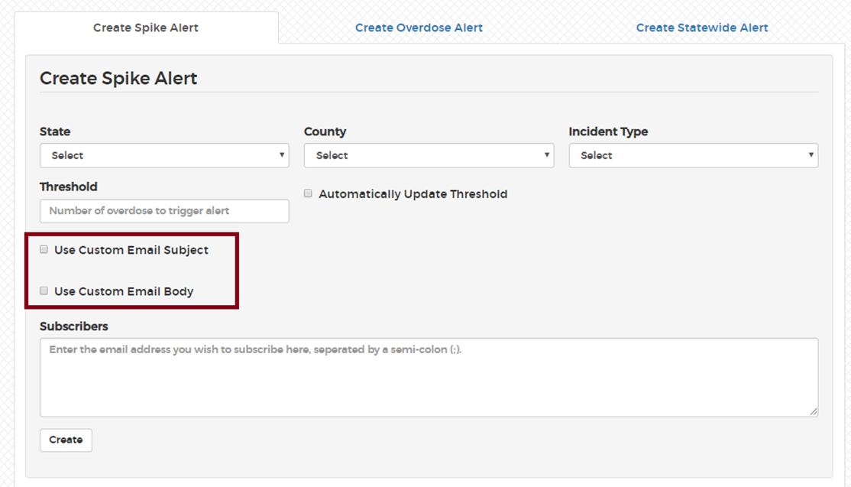
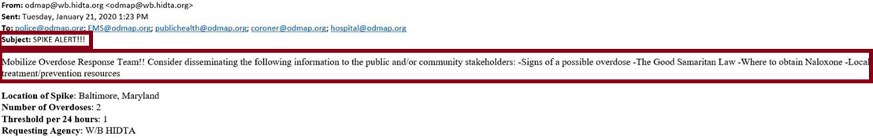
Creating Spike Alerts
Step 1: Select the State of Interest
Step 2: Select the County of Interest
Step 3: Select the Incident Type
Alerts may be setup for only fatal or non-fatal, or for both combined.
Step 4: Enter the Threshold
A spike threshold can be set to any desired number. ODMAP will provide a recommendation for the spike threshold, utilizing a formula of 2 standard deviations above the mean. If a county has not entered data yet, the default recommendation is 3.
Step 5: Create Custom Spike Alert Messages
The administrator can choose to either use the standard ODMAP alert email, or create a custom spike alert email subject, email body or both. This only applies to the initial email that is sent when a spike starts.
Step 6: Enter Subscribers
The administrator may list as many subscribers as they deem appropriate. It is recommended to include police chief, fire/EMS chief, local health officer, and any others who play a key role in responding to a sudden increase in overdoses.
Step 7: Automatically Update Threshold
By checking this box, the threshold will automatically adjust as the ODMAP recommended value changes, based on entered data.

Slide 18

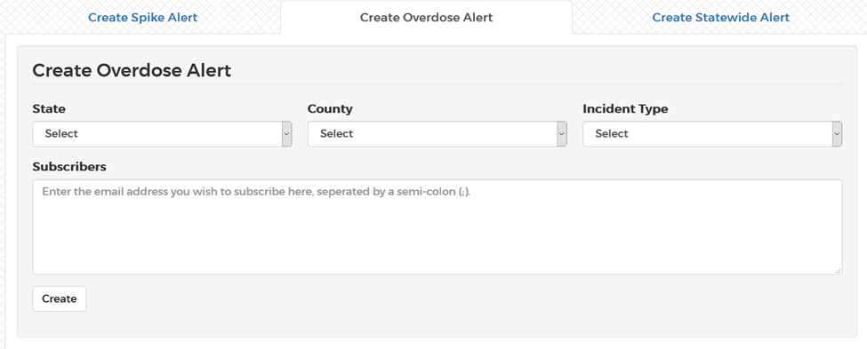
Creating Overdose Alerts
An overdose alert can be created to send an email each time an overdose is entered for a specific county
Step 1: Select the State of Interest
Step 2: Select the County of Interest
Step 3: Select the Incident Type
Alerts may be setup for only fatal or non-fatal, or for both combined
Step 4: Enter Subscribers
The administrator may list as many subscribers as they deem appropriate

Slide 19

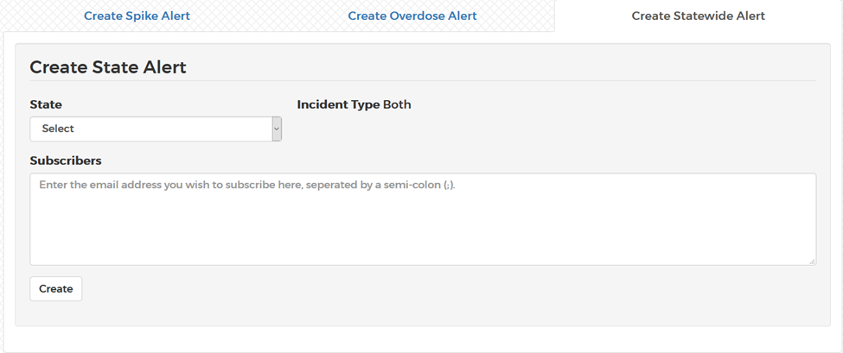
Creating Statewide Alerts
Alerts can be created for when any county in a state experiences a spike. For a statewide alert the ODMAP spike formula must be used. The threshold will be automatically updated according to data submitted. Statewide alerts must also be for both fatal and non-fatal.
Step 1: Select the State of Interest
Step 2: Enter Subscribers
The administrator may list as many subscribers as they deem appropriate

Slide 20

Connect with ODMAP
Visit our website
Please visit to our website for the latest materials
http://odmap.org/
Please subscribe to our YouTube Channel for the latest training materials
https://www.youtube.com/watch?v=1WiTfh5suk8
  YouTube channel contains the following videos:
    Overview of Level 1 platform to include Administrator capabilities
    Overview of creation and implementation of spike alerts
    Overview of level 2 platform
    ODMAP and Public Health
    Home screen shortcut
  ODMAP website contains the following:
    Policies and Procedures
    Overdose Spike Response Framework
    Participating Agency Map
    ODMAP Training
      Training Manual
      FAQ
      Gaining agency access
      Tutorial for Law Enforcement
      Tutorial for Fire/EMS

